Slide 1
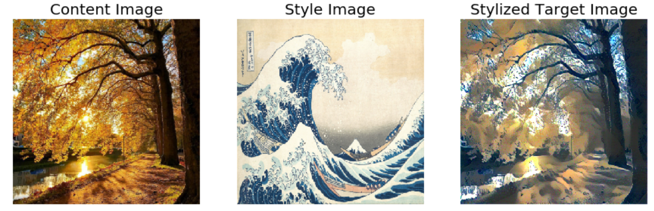
Style transfer project
Clara BOMY – Philémon ROUBAUD – Lu XU

Slide 2
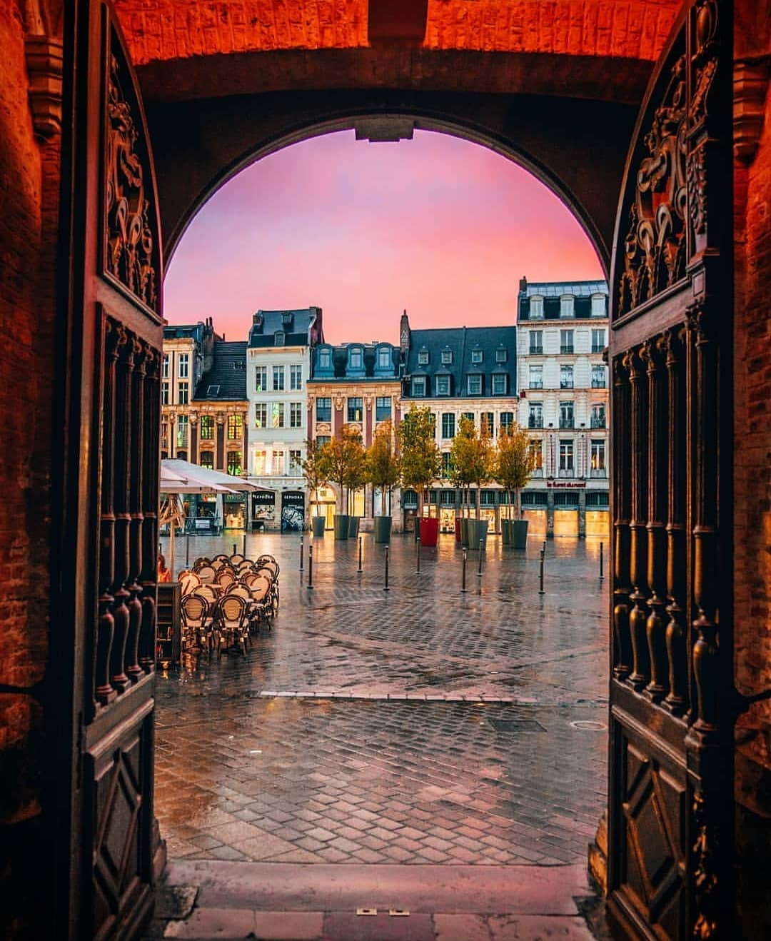
Inspiration

Slide 3
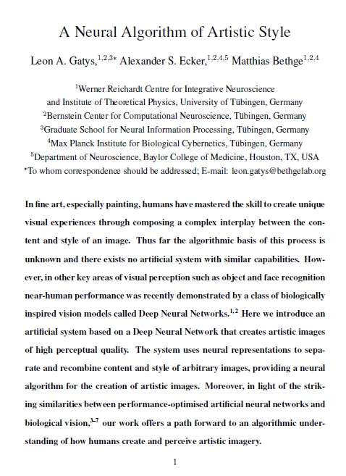
Research article to understand the concept
https://arxiv.org/abs/1508.06576

Slide 4

Medium Article to scrap images
https://medium.com/@intprogrammer/how-to-scrape-google-for-images-to-train-your-machine-learning-classifiers-on-565076972ce

Slide 5
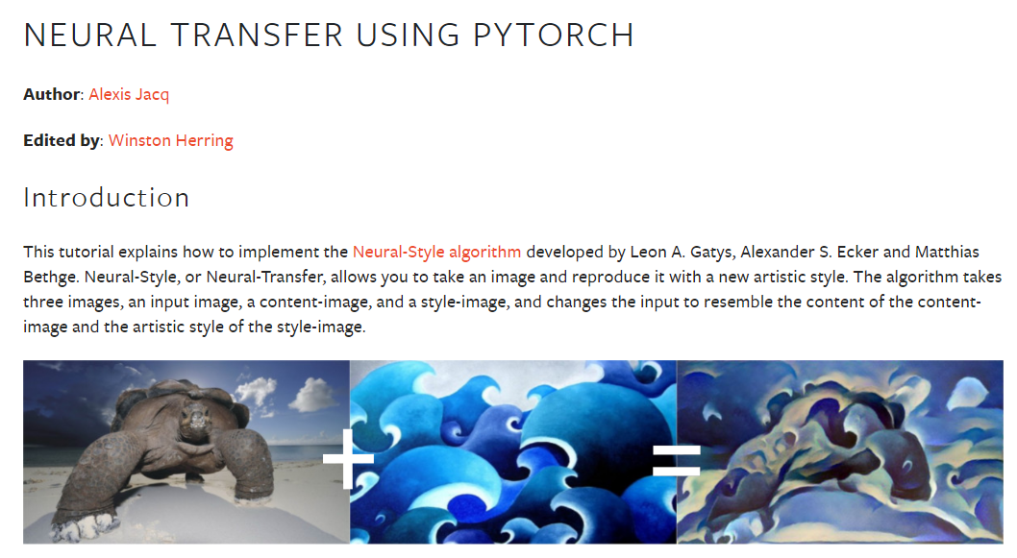
Pytorch tutorial
https://pytorch.org/tutorials/advanced/neural_style_tutorial.html

Slide 6

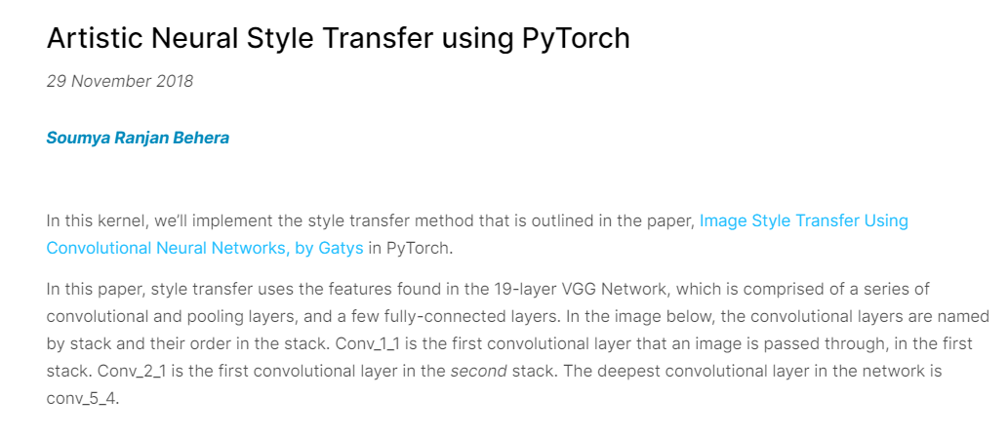
Kaggle notebook
https://www.kaggle.com/soumya044/artistic-neural-style-transfer-using-pytorch

Slide 7
That we have changed
Script to upload images from Instagram (Instaloader and Fastai libraries, lillemaville Instagram account)
Use of Google Colab to harness the power of GPU
Creation of a Dataset class and a Dataloader class for content images
Creation of a class for the model used
Script to be able to test different styles on a given image and save all the generated images in a same folder

Slide 8
Test performs
Tests of different models (VGG16, VGG19, Resnet50)
Variations in the weights applied to style and content for the calculation of the total loss
Variations on the number of epochs and on the learning rate
Controlled parameters:
Model : VGG19
Alpha(content) = 1; Beta(style) = 1e9
EPOCHS = 2000
Learning Rate = 0.003

Slide 9
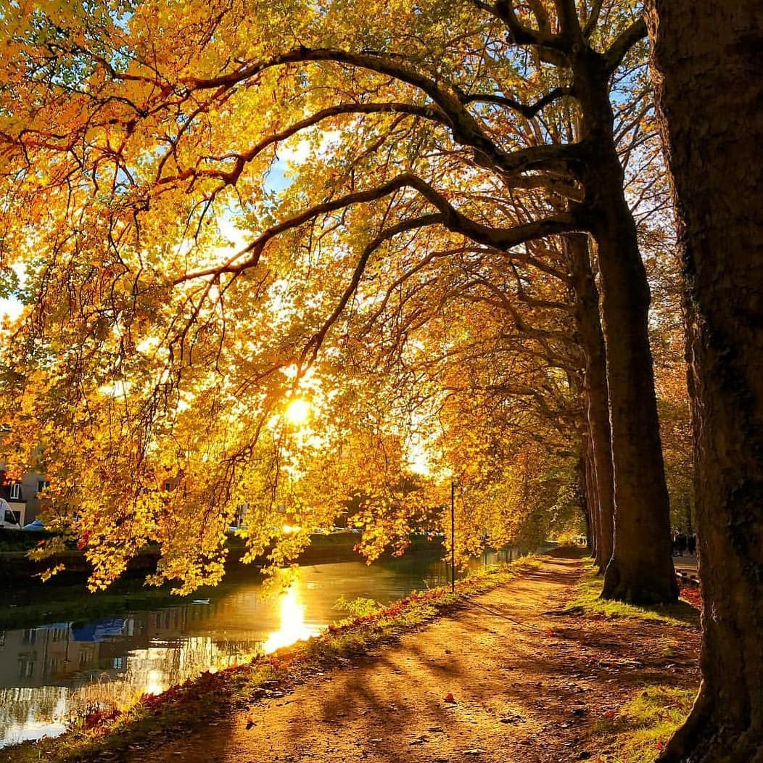
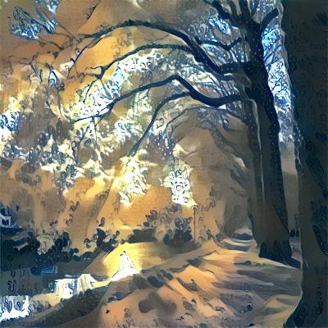

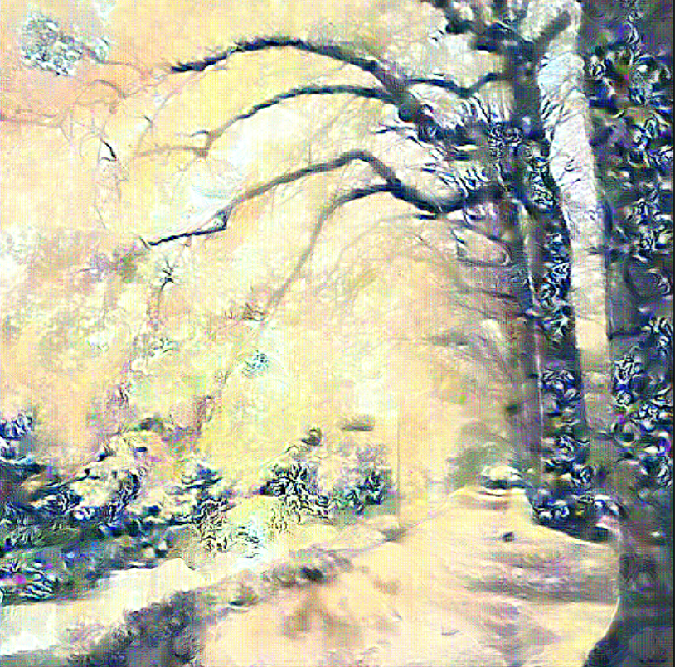
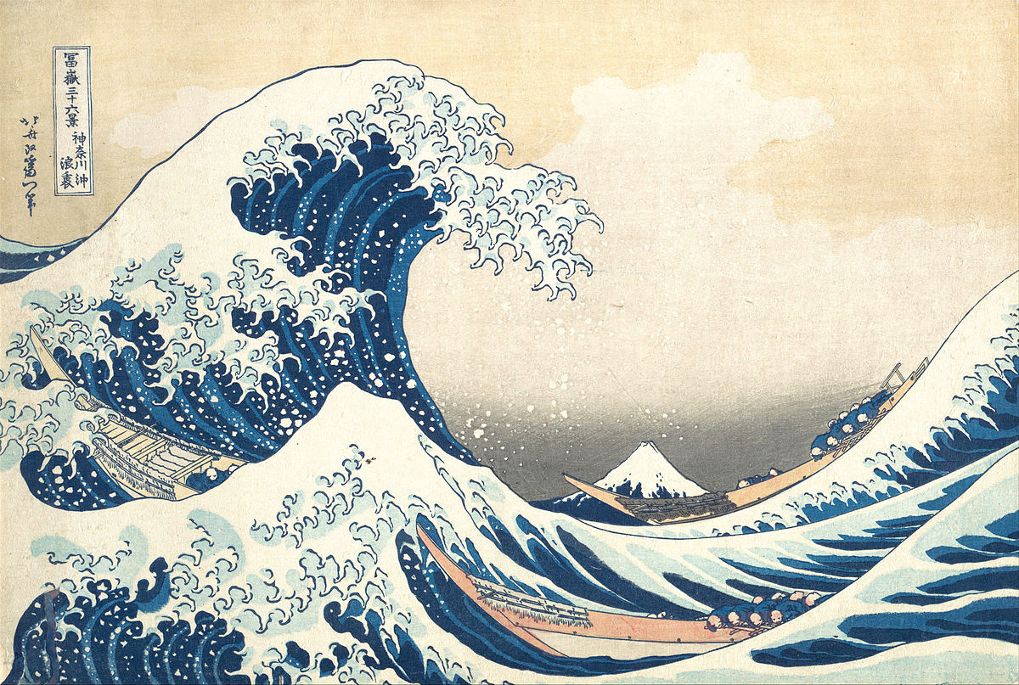
Different models
VGG16
VGG19
ResNet50
Notes:
ResNet50 is different to VGG19 which is used in the paper. It seems that due to the complexity of ResNet50, the feature maps do not work as well as those of VGG16 or VGG19. In order to obtain a better generated image, trial and error using different combinations for content and style layers as well as hyperparameters (learning rate, content weight, and style weight) is needed.

Slide 10
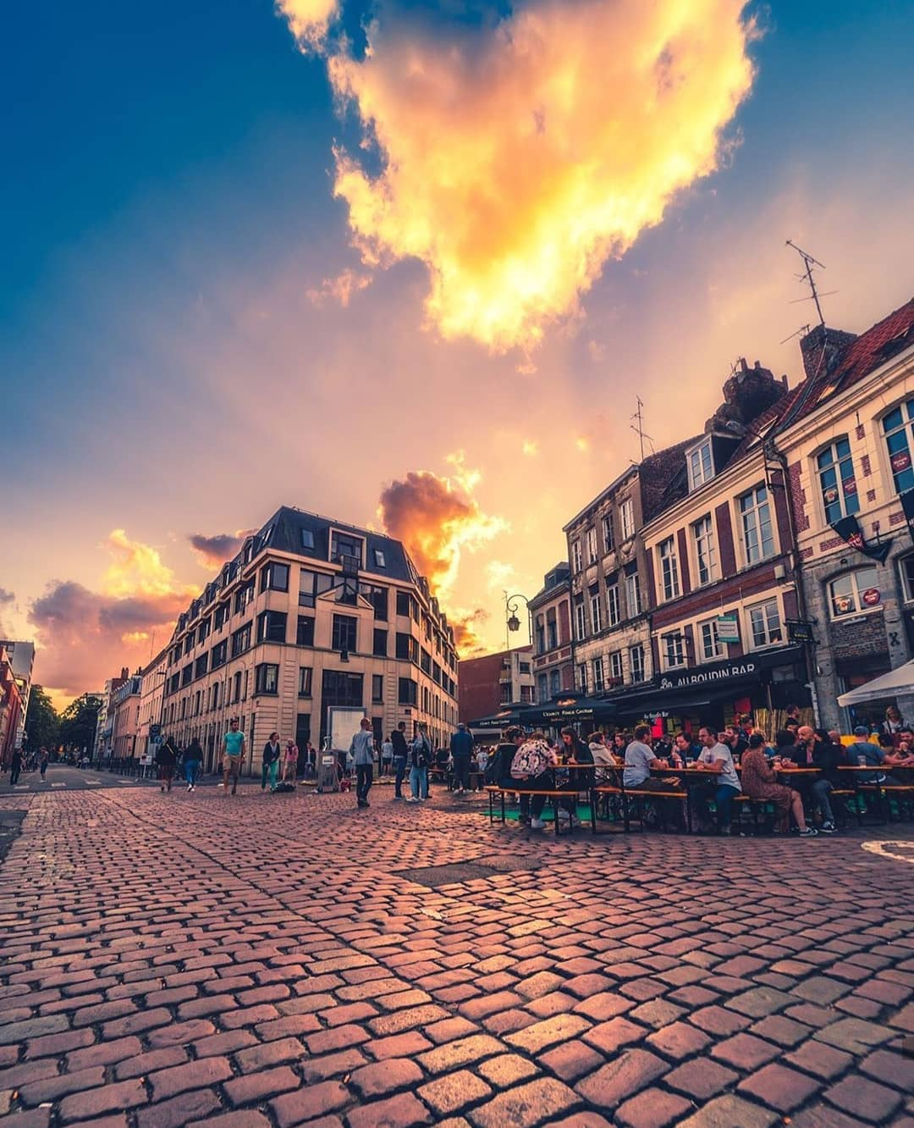
Variations in the weights applied to style and content for the calculation of the total loss
Notes:
we define an alpha (content_weight) and a beta (style_weight). This ratio will affect how stylized your final image is.
then how do I combine the style and content?
Now it gets interesting. We can compute the difference between the styles of two images (style loss) as the difference between the activations of the style filters for each image. Same thing for the difference between content of two images (content loss): it’s the difference between the activations of the filters in the content layers of each image.
Let’s say we want to combine a the style of wave with a picture of lille. The combination image starts off as random noise. As the combination image goes through the CNN, it excites some filters in the style layers and some in the content layers. By summing the style loss between the combination image and the wave, and the content loss between the combination image and the picture of lille, we get the total loss.

Slide 11
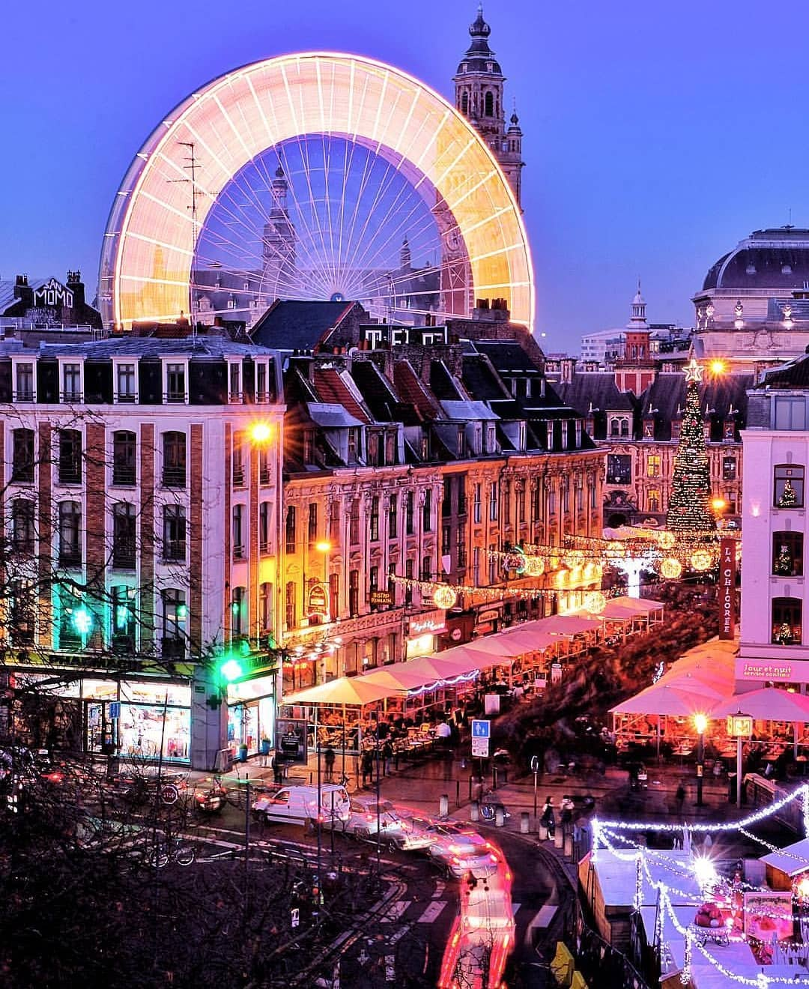
Variations on the learning rates

Slide 12
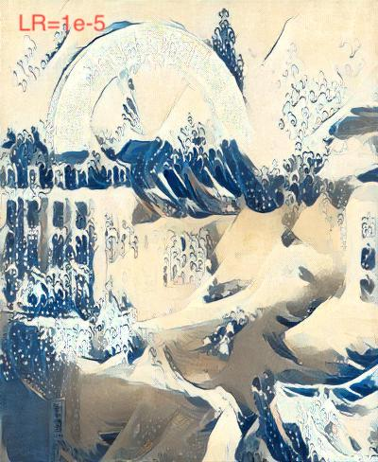
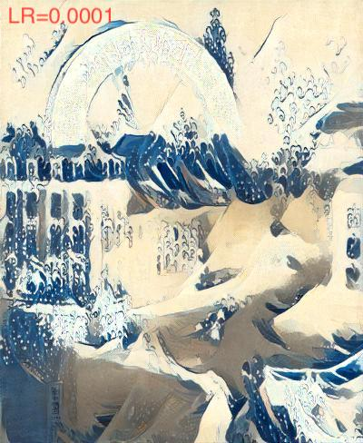
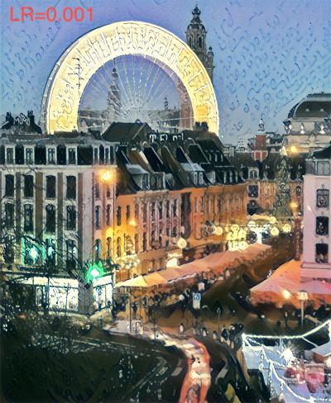

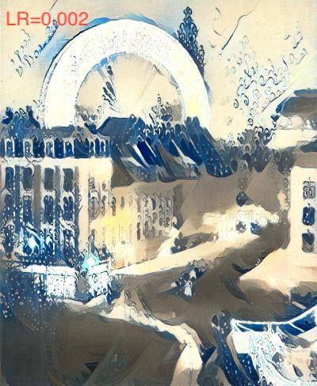

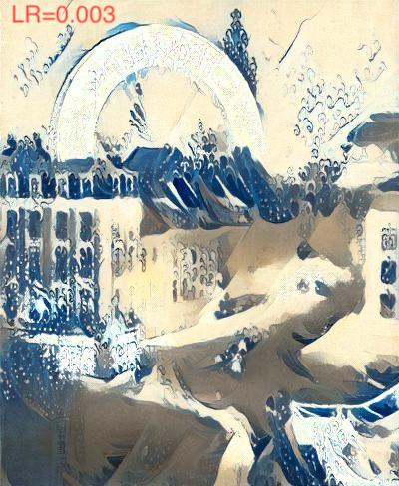
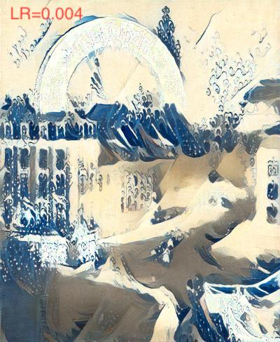


Notes:
Learning rate affects how much the image is changed in each iteration, when the optimization algorithm is trying to find minimum loss. If the learning rate is small, more iterations are likely to be needed. If the learning rate is too large, too big changes are made and the search for optimum might not behave correctly.

Slide 13
Variations on the number of epochs

Slide 14
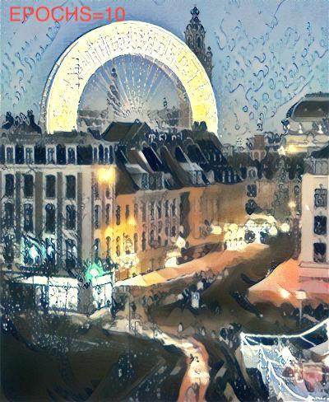
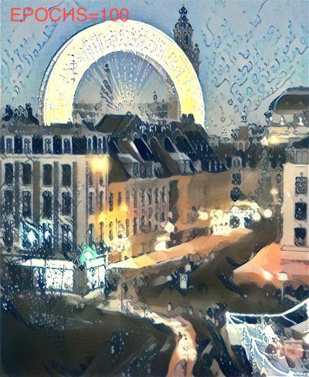
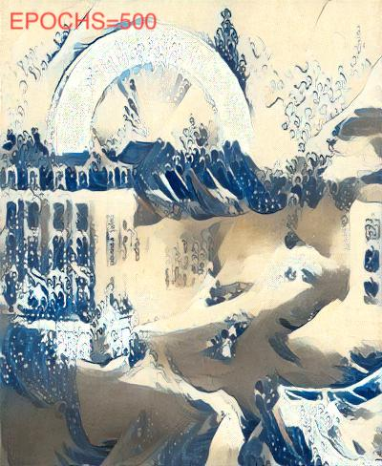
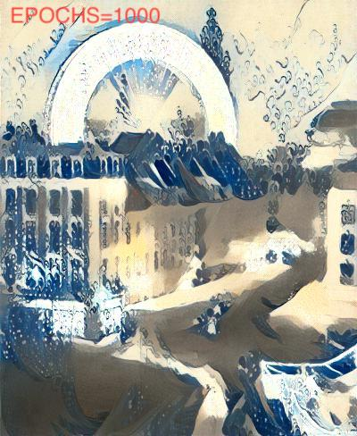

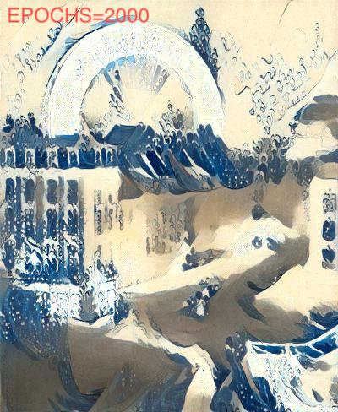
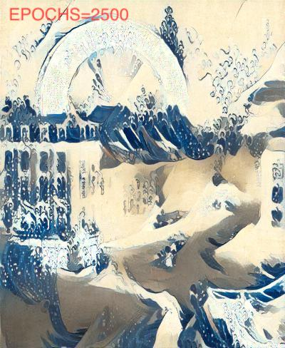


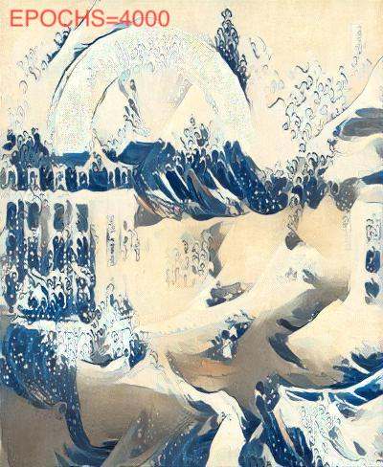
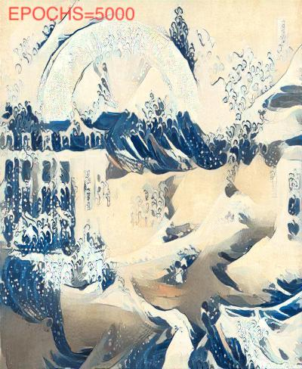
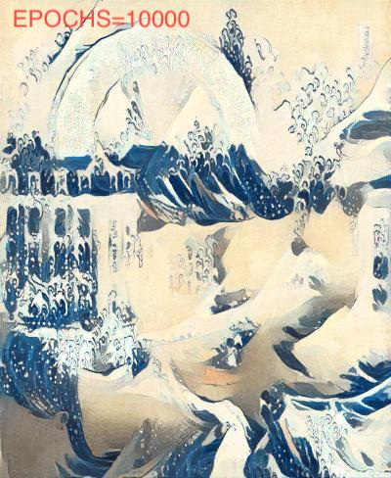

Slide 15
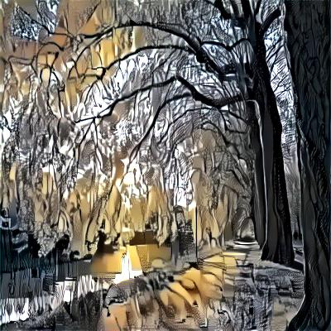
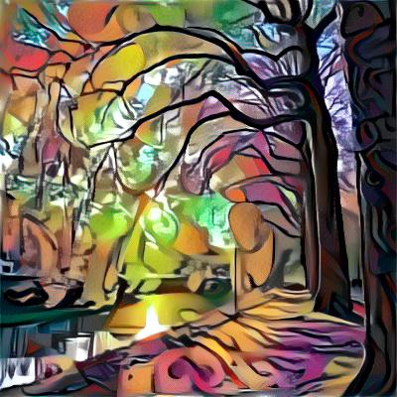
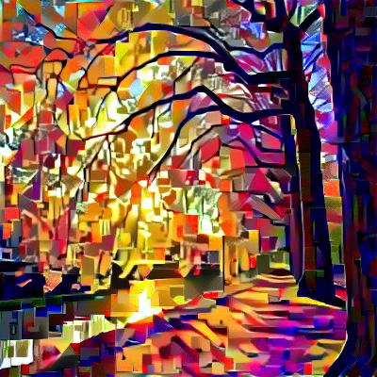
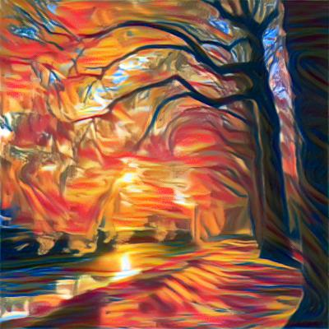
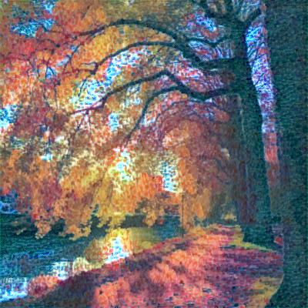
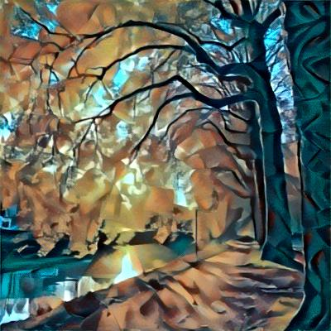

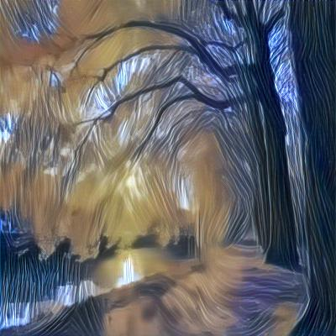
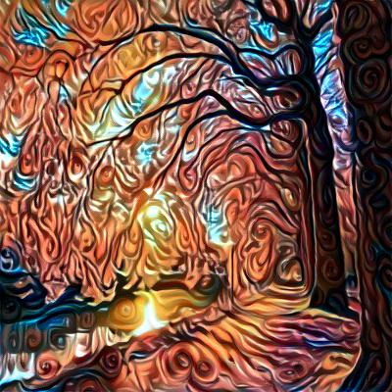
Results

Slide 16
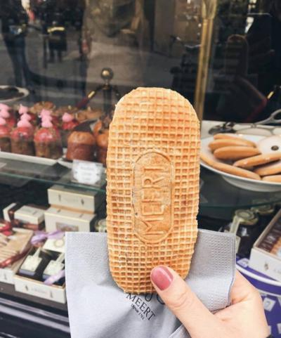
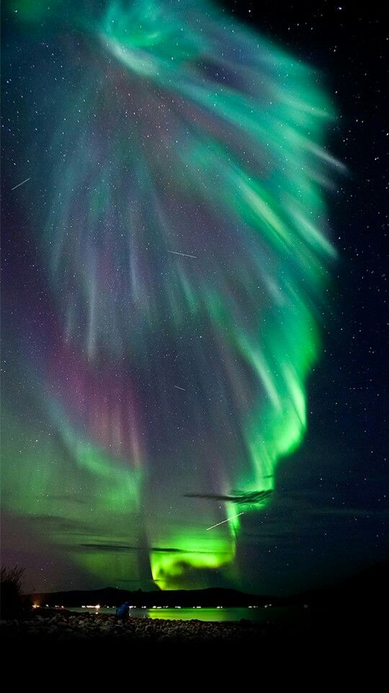
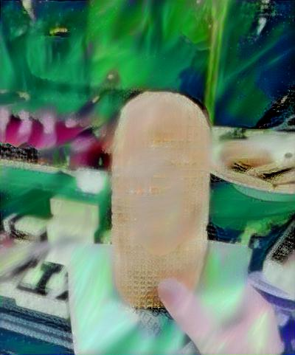
Interesting observations
Poor results (blurring, smearing) when the style is diffuse
Good results when the style is pronounced with visible lines and contours
If the colors of the content and the style are very close or if one of the two is close to a neutral color, the result is generally better

Slide 17
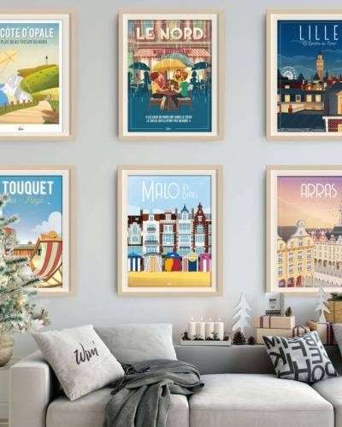
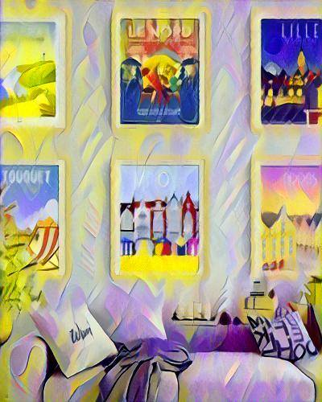
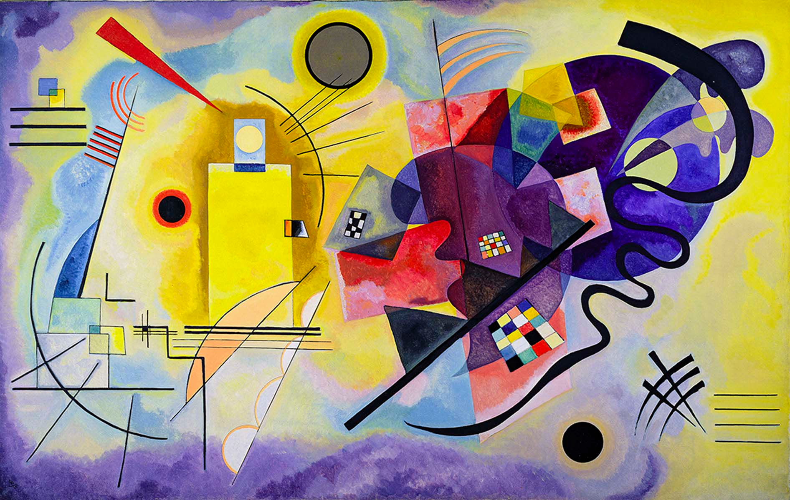
With certain styles, content can be altered

Slide 18
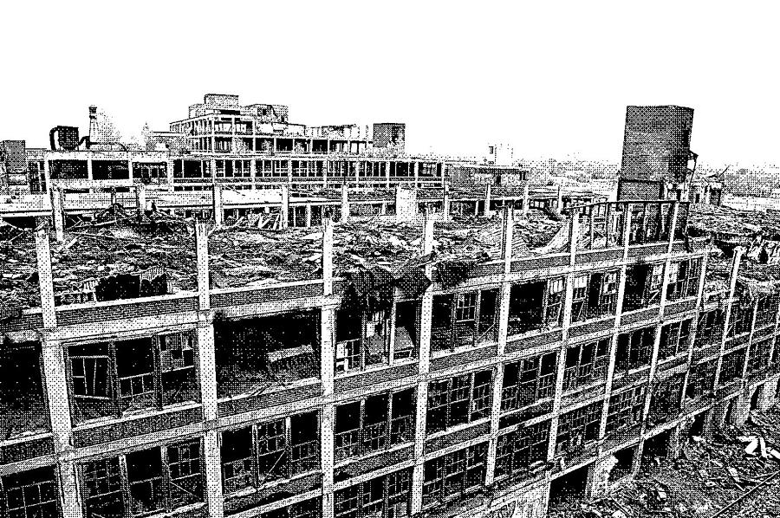
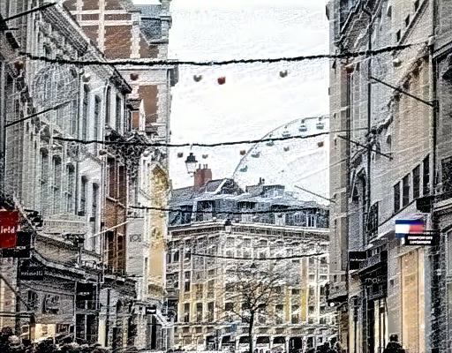
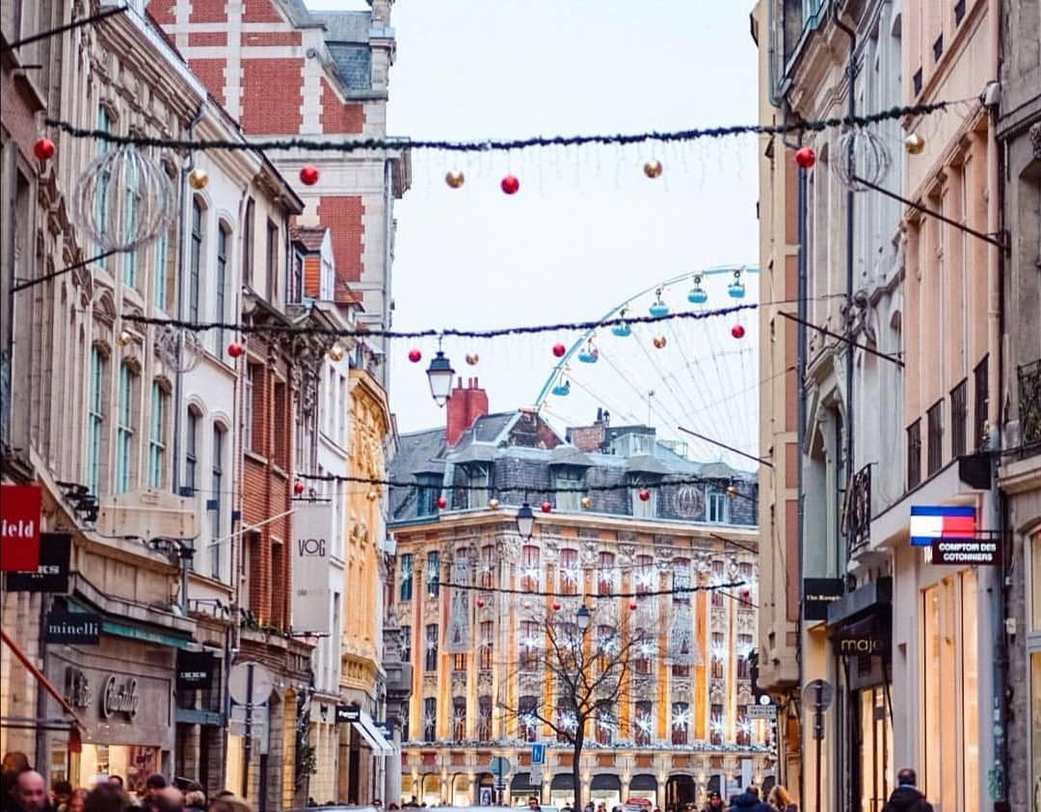
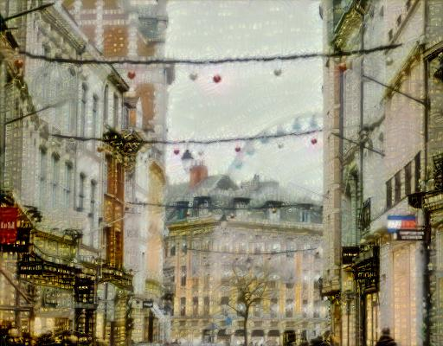
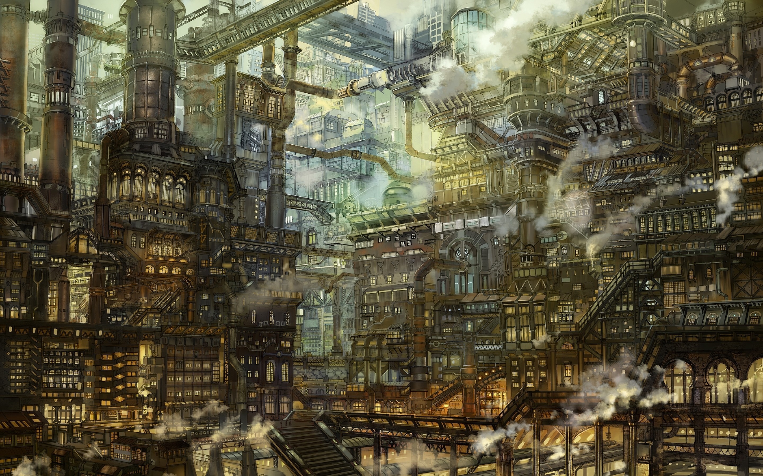
Depending on the style image chosen, the style may not be very visible

Slide 19
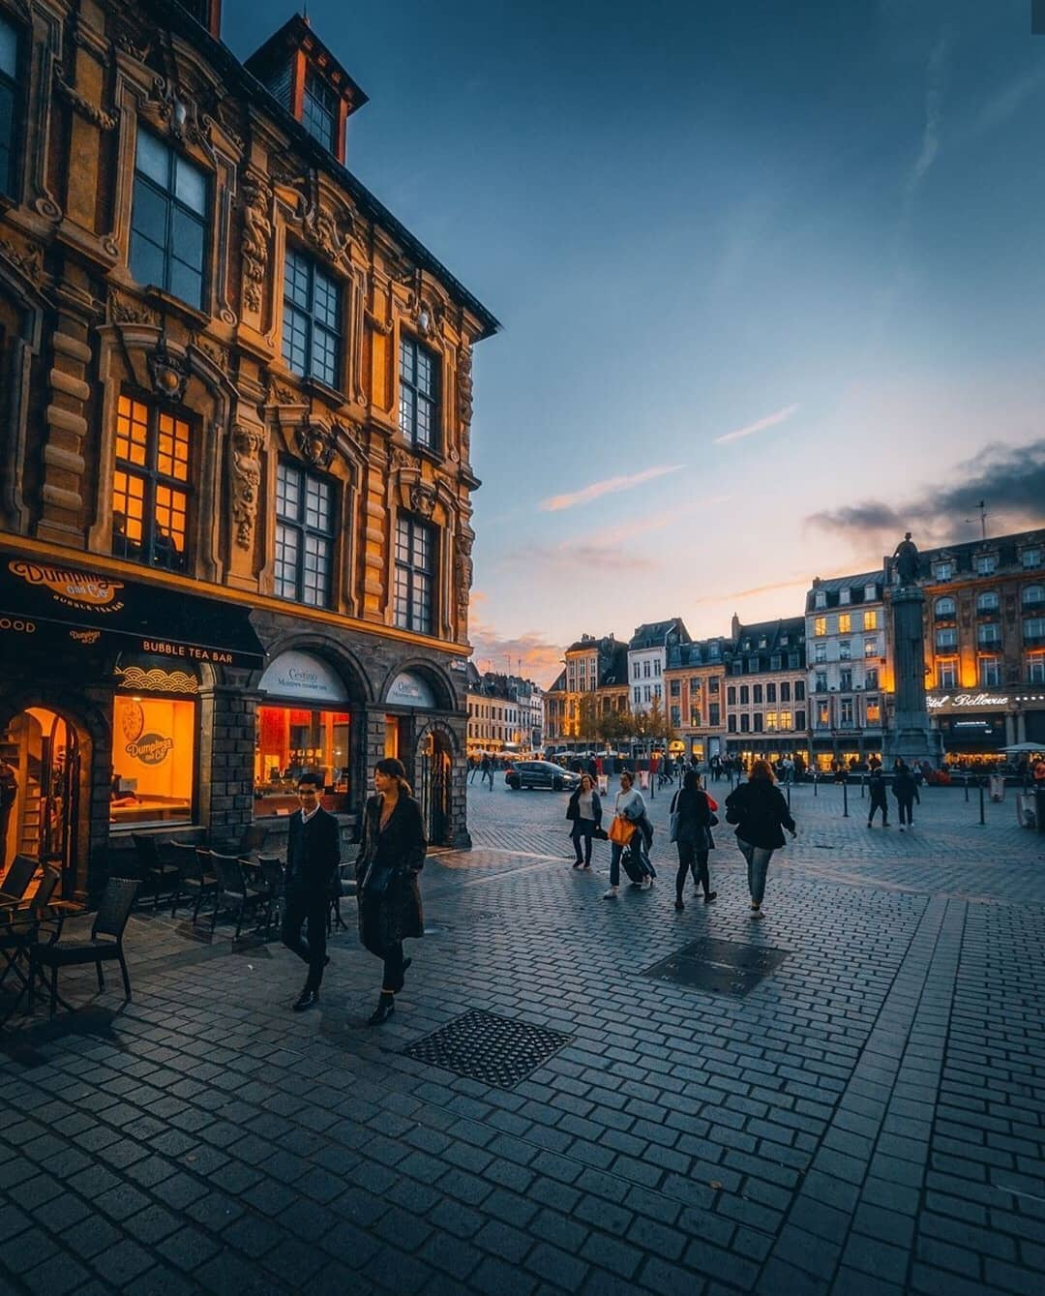
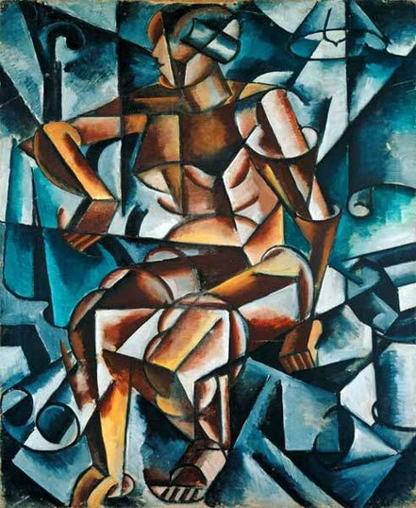
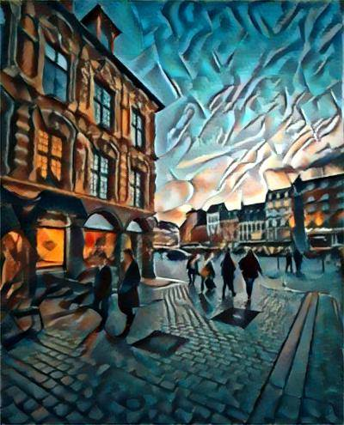
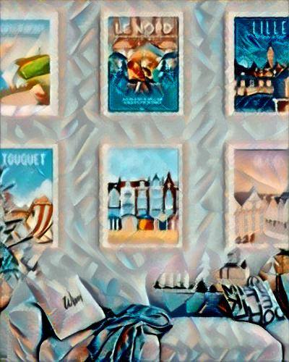
Some styles are not suitable for certain images

Slide 20
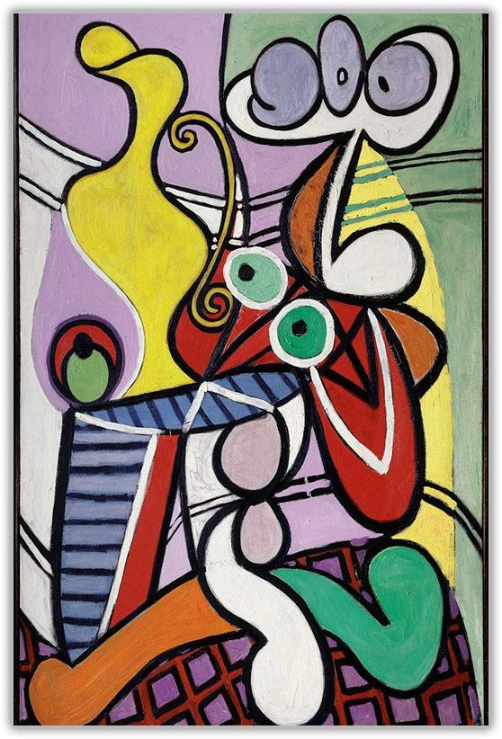











Slide 21










Slide 22







Slide 23






Slide 24












Slide 25


Slide 26



Slide 27



Slide 28



Slide 29



Slide 30
image gallery
image gallery
Image gallery

Slide 31


Slide 32




Slide 33


